Slide 1
Performance evaluation of a reflex blood-based methylated ctDNA multi-cancer early detection test in individuals with obesity
Dax Kurbegov¹ MD, Elie Massaad² MD, MSc, A. Gregory DiRienzo² PhD, Johanna B Withers² PhD, Dorna Kashef² PhD, Jocelyn Charlton² PhD, James Sun² PhD, Franziska Michor³ PhD, Kieran Chacko² PhD, Luke Pike⁴ MD DPhil, Hutan Ashrafian² MD PhD
¹Sarah Cannon Research Institute, Nashville, TN; ²Harbinger Health, Cambridge, MA; ³Dana-Farber Cancer Institute, Boston, MA; ⁴Memorial Sloan Kettering Cancer Center, New York, NY
Dax Kurbegov, MD, FASCO

Slide 2
Key Points
Multi-cancer early detection (MCED) testing represents an opportunity to address a critical screening gap in individuals with obesity
A reflex blood-based MCED test demonstrated clinically meaningful per-cancer PPV and early-stage sensitivity for multiple cancers without screening programs in the general population
Results warrant prospective validation to assess the test’s clinical validity and utility in early-stage cancer detection in this high-risk population.
Dax Kurbegov, MD, FASCO

Slide 3
Background
Obesity now affects ~ 40% of adults in the United States, and is a major risk factor for numerous conditions¹
Obesity contributes to ~84,000 new cancer cases in the U.S. annually – second only to tobacco as a preventable cause^{1,2}
Excess body weight is implicated in 15–20% of cancer-related mortality³
13 obesity-associated cancers represent ~40% of all U.S. cancer diagnoses, most without screening programs⁴
Rising incidence among younger adults underscores the urgent need for expanded early detection strategies²
1.Obesity and severe obesity prevalence in adults: United States, August 2021–August 2023. NCHS Data Brief 2024 2. AACR Cancer Progress Report 2024 3. American Society of Clinical Oncology position statement on obesity and cancer. J Clin Oncol. 2014
4. National Cancer Institute. Obesity and Cancer Fact Sheet. Updated 2022.
Dax Kurbegov, MD, FASCO
Notes:
Rates of obesity have increased significantly over the last three decades in the United States and globally. In addition to contributing to heart disease and diabetes, obesity is a major unrecognized risk factor for cancer
Obesity is a major under-recognized contributor to the nation's cancer toll and is quickly overtaking tobacco as the leading preventable cause of cancer. As many as 84,000 cancer diagnoses each year are attributed to obesity, and overweight and obesity are implicated in 15% to 20% of total cancer-related mortality.
https://ascopubs.org/doi/10.1200/JCO.2014.58.4680
Obesity is a major unrecognized risk factor for cancer
In 2014, an estimated seven and eight percent of all U.S. cancer cases and deaths, respectively, were attributable to excess body weight. Beyond cancer, obesity increases the risk of developing several other health problems including type 2 diabetes, high blood pressure, heart disease, stroke, liver disease, and kidney disease (169)Harrison R. The State of Obesity: 2019. 1905;10:1055.. Therefore, it is concerning that in the U.S. and around the globe the prevalence of obesity has been rising steadily. In the United States, 42 percent of adults age 20 and older were obese in 2018, and according to a recent projection, by the year 2030, nearly 50 percent of all U.S. adults age 18 and older will have obesity
Concurrent with the steady rise in obesity rates in the United States, the incidence of several obesity-associated cancers has also been rising at an alarming rate, especially among young adults
https://cancerprogressreport.aacr.org/progress/cpr20-contents/cpr20-preventing-cancer-identifying-risk-factors/
A nationwide cross-sectional study using BMI and cancer incidence data from the US Cancer Statistics database estimated that each year in 2011 to 2015 among people ages 30 and older, about 37,670 new cancer cases in men (4.7%) and 74,690 new cancer cases in women (9.6%) were due to excess body weight (overweight, obesity, or severe obesity) (39). The percentage of cases attributed to excess body weight varied widely across cancer types and was as high as 51% for liver or gallbladder cancer and 49.2% for endometrial cancer in women and 48.8% for liver or gallbladder cancer and 30.6% for esophageal adenocarcinoma in men.
https://www.cancer.gov/about-cancer/causes-prevention/risk/obesity/obesity-fact-sheet
Obesity increases risk of 13 distinct cancers, most without screening programs: collectively representing 40% of all annual US cancer diagnoses. With recent CDC data (2023) showing obesity rates exceed 35% in 23 U.S. states, multi-cancer early detection (MCED) testing represents a unique opportunity to address a critical screening gap in this population. In this case-control study, we examined the performance of a reflex blood-based ctDNA methylation MCED test in individuals with obesity (BMI ≥ 30 kg/m²), evaluating cancer-specific intrinsic accuracy (sensitivity) and positive predictive value (PPV).

Slide 4
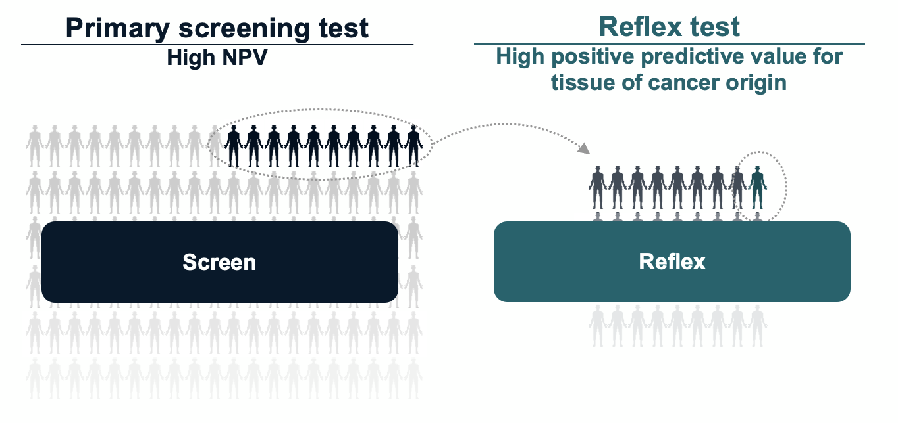
Opportunity: Multi-Cancer Early Detection Tests
Develop a circulating tumor DNA (ctDNA) reflex screening test for early detection of multiple cancers based upon DNA methylation signature derived from developmental biology​¹
Address an unmet need for population-level early detection by interrogating cancers without screening programs, particularly among individuals with obesity, where cancer risk is high and clinical guidelines are limited
Dax Kurbegov, MD, FASCO
1. Smith ZD, Shi J, Gu H, et al. Epigenetic restriction of extraembryonic lineages mirrors the somatic transition to cancer. Nature. 2017

Slide 5
CORE-HH Study Design
Prospective, multi-center, case-control study in participants from 126 clinical sites in the U.S. (NCT05435066)
Cancer Arm (Cases)
20+ tumor types across solid and hematologic cancers
Key inclusion Criteria
Age 20–79 years
Confirmed cancer (pathology or imaging)
Treatment-naïve
Single blood draw
Controls followed for 1 year to confirm cancer-free status
Primary Objective
Development and validation of a reflex blood-based MCED
Per-cancer Intrinsic Accuracy¹ (Sensitivity)
Specificity
TOO-specific predictive values
Non-Cancer Arm (Controls)
Key inclusion Criteria
Age 20–79 years
Not suspected of having cancer at enrollment
No cancer diagnosis or treatment within the past 5 yrs
Exclusion criteria for both arms: Self-reported pregnancy at enrollment; prior organ or non-autologous stem cell transplant
¹Intrinsic accuracy is the proportion of correct TOO readout category among cases of a specific cancer type
Dax Kurbegov, MD, FASCO

Slide 6
Methods: Evaluation of a Reflex MCED
Leverage a novel methodological framework¹ that circumvents limitations of conventional MCED metrics (aggregate PPV, standalone TOO agreement, sensitivity)
Evaluation of cancer-specific metrics enhance clinical decision-making by quantifying risk-benefit ratios per TOO readout
Conventional sensitivity: the probability of a positive test regardless of TOO readout when a cancer is present
Intrinsic Accuracy: Probability of correct TOO readout category among cases of a given cancer type
TOO-specific PPV: Probability of correct case type among subjects with a given TOO readout
Result reporting
for overall disease P(D)
Estimated at 1.6 per 100 person-years follow-up for individuals 40 and older with obesity (BMI ≥30 kg/m²) ²⁻³
Cancer
cases
Controls
¹Massaad, DiRienzo, et al. Novel performance quantification of MCED testing to aid clinical decisions: Analysis of a sequential reflex blood-based methylated ctDNA test [abstract]. In: Proceedings of the AACR Meeting 2025; Cancer Res 2025;85(8_Suppl_2)
²Basen-Engquist K, Chang M. Obesity and cancer risk: recent review and evidence. Curr Oncol Rep. 2011;13(1):71-76.
³Sun JY, Huang WJ, Hua Y, et al. Trends in general and abdominal obesity in US adults: Evidence from the National Health and Nutrition Examination Survey (2001-2018)
Dax Kurbegov, MD, FASCO

Slide 7
Results: Validation Cohort Characteristics in Individuals Aged ≥ 40 Years with Obesity¹
Characteristics | Cancer (N=408) | Non-Cancer (N=354)
Sex
Female | 239 (58.6%) | 225 (63.6%)
Male | 169 (41.4%) | 129 (36.4%)
Age
Mean (SD) | 62.6 (9.7) | 58.1 (9.7)
(Min, Max) | 40, 79 | 40, 78
Race
White | 318 (77.9%) | 202 (57.1%)
Black or African American | 39 (9.6%) | 127 (35.9%)
Asian | 2 (0.5%) | 4 (1.1%)
American Indian or Alaska Native | 5 (1.2%) | 0 (0.0%)
Native Hawaiian or other Pacific Islander | 2 (0.5%) | 1 (0.3%)
Two or more races | 1 (0.2%) | 1 (0.3%)
Other race | 7 (1.7%) | 5 (1.4%)
Unknown/Missing/Not reported | 34 (8.3%) | 14 (4.0%)
Ethnicity
Not Hispanic/Latino | 335 (82.1%) | 314 (88.7%)
Hispanic/Latino | 33 (8.1%) | 30 (8.5%)
Distribution of cancer types and stages in the study
Early Stage (I-II)
Late tage (III-IV)
Unstaged
Breast
Others
Uterine
Lung
Lymphoid-line
Prostate
Colorectal
Pancreas
Upper GI
H&N
Liver
Biliary tract
Upper GI includes Esophageal, EGJ, and Gastric cancers
Others are cancer types not used to train the tissue of origin model due to low sample counts:​ Ovarian, Renal, Anal, Neuroendocrine, Cervical, Melanoma, Bladder, Myeloid, Soft tissue, Sarcoma, Other.
¹BMI ≥30 kg/m²
Dax Kurbegov, MD, FASCO

Slide 8
Results: Reflex MCED Performance of Cancer Signal Detection
408 Cancer
354 Non-cancer
The Primary Screening test achieved 60.5% sensitivity at 80% target specificity
Overall sensitivity of the reflex test at 98.3% specificity, 95% CI (96.5, 99.3), achieved:
762 Samples Undergo Primary Testing
161
Cancer signal not detected
280
Cancer signal not detected
321
Samples proceed to reflex testing
Conventional sensitivity¹, overall | 43.4%
Early stage (I-II) | 25.8%
Late stage (III-IV) | 80.3%
Overall, for cancers without a screening program in U.S. general population² | 50.9%
177 classified as cancer
70 incorrectly classified as non-cancer
68
correctly classified as non-cancer
6
incorrectly classified as cancer
¹Conventional sensitivity is defined as the probability of detecting a cancer signal when a cancer is present
² Cancers with screening programs are Breast, Colorectal, Lung, Prostate, Cervix
Dax Kurbegov, MD, FASCO

Slide 9
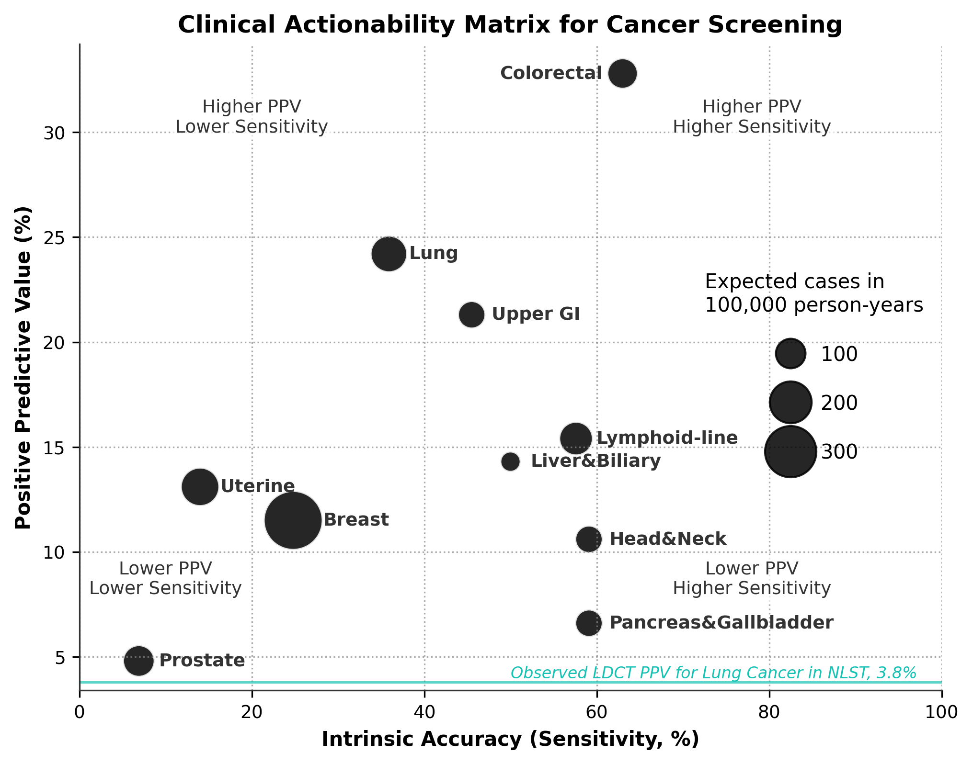
Results: TOO-specific Performance Metrics
Overall intrinsic accuracy for correct TOO is 36%, 95% CI (30.9, 40.9)
In a modeled 100,000-person cohort, the test identified 51 of 86 pancreaticobiliary cancers, including 8 of 31 early-stage
For hepatobiliary cancers, a 35% early-stage intrinsic accuracy indicates a clinically meaningful performance
Cancers with higher PPVs: Upper GI (22%), Colorectal (33%), indicates a higher likelihood of true disease with a test readout
¹ Upper GI includes Esophageal, EGJ, and Gastric cancers
Dax Kurbegov, MD, FASCO
National Lung Screening Trial Research Team, Church TR, Black WC, et al. Results of initial low-dose computed tomographic screening for lung cancer. N Engl J Med. 2013

Slide 10
Limitations
Cancer participants were treatment‑naïve and often symptomatic; Non-cancer participants were convenience sourced.
Stage distribution and comorbidity profiles may not mirror a truly asymptomatic screening population
Model was trained on a mixed‑BMI cohort and calibrated within individuals with BMI ≥ 30 kg/m²
Cancer‑specific PPVs were estimated using overall incidence of 1.6 per 100 person-years follow-up and observed cancer-specific incidence from data along with estimates of intrinsic accuracy and specificity; truly prospective determinations of PPV and NPV are obtained using a prospective screening cohort with real‑world prevalence
Dax Kurbegov, MD, FASCO

Slide 11
Conclusions
The reflex cfDNA‑methylation MCED test achieved clinically meaningful per-cancer intrinsic accuracy and per-TOO PPV across all cancer types evaluated in individuals at-risk with obesity
High performance was observed for cancers lacking organized screening programs (e.g., pancreaticobiliary, hepatobiliary), highlighting a critical clinical gap the test could address
Per-TOO PPV weighs the likelihood of true disease against the risks, costs, and invasiveness of follow‑up diagnostics, which could inform a more balanced and personalized decision-making process for work‑up
Dax Kurbegov, MD, FASCO

Slide 12
Key Takeaways
Multi-cancer early detection (MCED) testing represents an opportunity to address a critical screening gap in individuals with obesity
A reflex blood-based MCED test demonstrated clinically meaningful per-cancer PPV and early-stage sensitivity for multiple cancers without screening programs in the general population
Results warrant prospective validation to assess the test’s clinical validity and utility in early-stage cancer detection in this high-risk population.
Dax Kurbegov, MD, FASCO

Slide 13
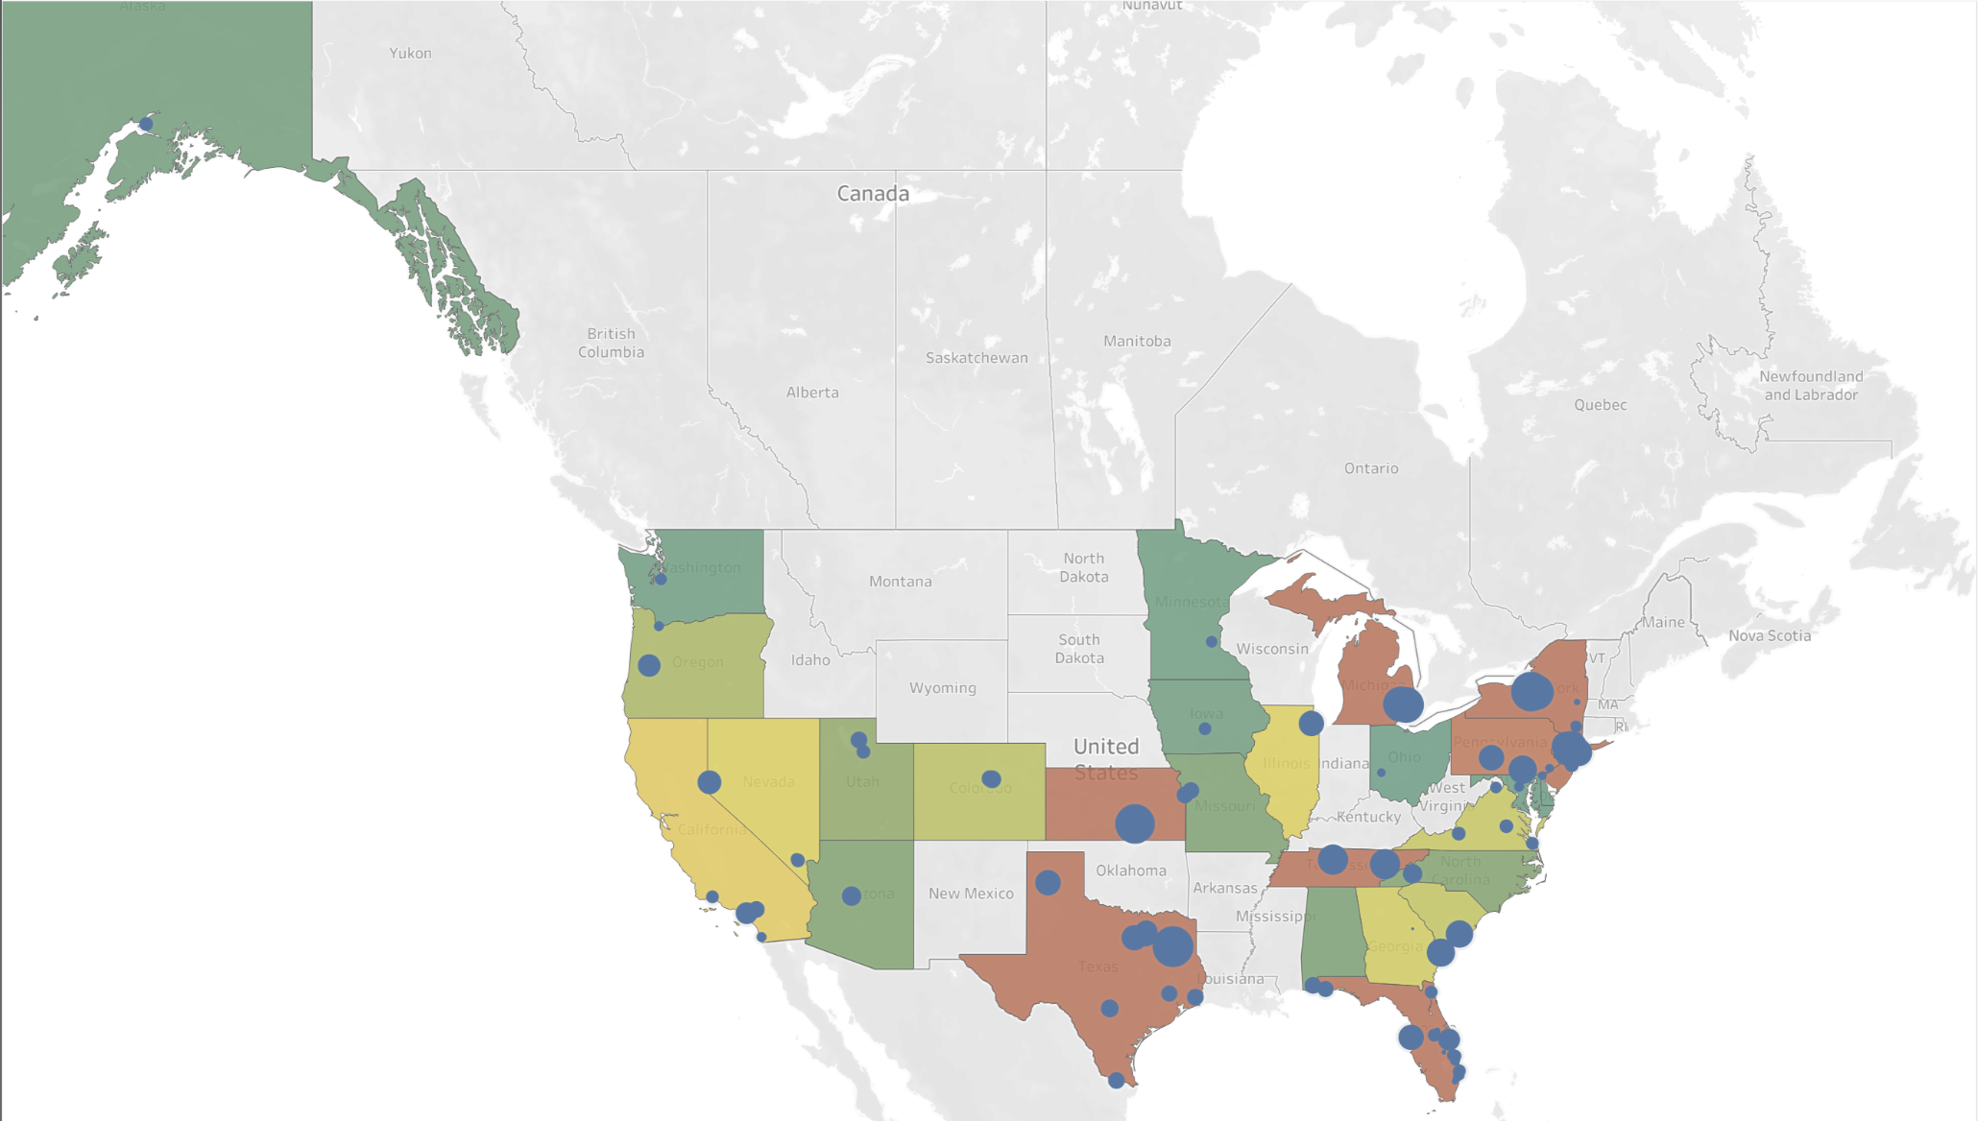
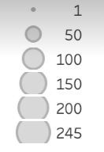

Acknowledgements
The authors would like to thank
The patients, their families and caregivers, and our healthy volunteers
Investigators and site personnel from 126 sites across 30 states
The CORE-HH study (NCT05435066) was sponsored by Harbinger Health
Color scale: Number of blood collection kits collected per state ; Circle size : Number of blood collection kits collected per site
Dax Kurbegov, MD, FASCO

Slide 14
What This Research Means for People with Obesity: A Blood Test to Help Detect Cancer Early
What did this research tell us?
This study evaluated a new blood test that can help detect many types of cancer early in people with obesity. The test looks for specific patterns in cell-free DNA (called DNA methylation) that may signal the presence of cancer. The test detected several types of cancer – some with no current screening options – with high accuracy and a low rate of false positives. This may help guide earlier diagnosis and inform decisions on follow-up care in people at increased risk of cancer.
Who does this research impact? This research is relevant for adults with obesity, a group at higher risk for multiple cancers. It may also inform healthcare providers looking for more accessible tools to support early cancer detection in this population.
What does this mean for patients right now? The test is under evaluation and not yet approved for clinical use. These findings suggest that, with further research, this type of blood test could support earlier cancer detection in individuals with obesity – potentially improving outcomes by enabling earlier intervention and informing decisions of follow-up care.
Dax Kurbegov, MD, FASCO

