Slide 1

CSHL Biological Data Science 2024
Training deep neural networks to extract tumor signal from cell-free DNA improves early cancer detection
Jackson A Killian¹, Dorna Kashef¹, Kade Pettie¹, Kyle Gowen¹, Shiva Farashahi¹, Esther Brown², Feras Hantash², Jocelyn Charlton¹, Kieran I Chacko¹
¹Harbinger Health, Machine Learning and Computational Biology, Cambridge, MA,
²Harbinger Health, Clinical Laboratory, Cambridge, MA

Slide 2
Early diagnosis of cancer saves lives
SEER 18 2009-2015, All races, females by SEER Summary Stage 2,000
Notes:
Don’t need to emphasize to this audience importance of cancer screening…
But here are some quick recent motivating stats about the importance of catching cancer early
Y-axis is five-year survival rate percentage
X axis is stage
the earlier the stage at diagnosis (farther left you are on this plot), the better the outcomes
Detecting cancer earlier is one of the best tools we have for improving cancer outcomes

Slide 3
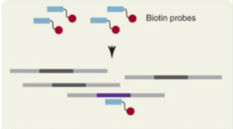

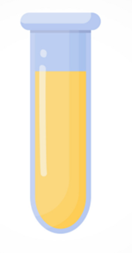


Early cancer detection via Harbinger’s liquid biopsy
Extract cell-free DNA
from blood plasma
Harbinger Assay
+Bisulfite conversion
+Hybrid Capture
Cancer Determination
Notes:
Harb improving early cancer detection via liquid biopsy
Blood draw, extract cfDNA from blood plasma, process with Harb assay (+bisu to capture methylation, and hybrid capture)
Then sequence + analysis to determine if cancer present in the sample

Slide 4
Early cancer detection via Harbinger’s liquid biopsy
Extract cell-free DNA
from blood plasma
Harbinger Assay
+Bisulfite conversion
+Hybrid Capture
Cancer Determination
Non-invasive
Low-cost
Multi-cancer
Notes:
* Desirable approach bc…

Slide 5
Focus of this talk: Computational
Extract cell-free DNA
from blood plasma
Harbinger Assay
+Bisulfite conversion
+Hybrid Capture
Cancer Determination
Non-invasive
Low-cost
Multi-cancer
Notes:
* Focus on this last computational step

Slide 6
Big data… but low signal: two major modeling challenges
One Patient
40Gb, 10k+ regions
Each patient generates a large, high-dimensional dataset
Notes:
* Each patient generates a wealth of data… 40gb over 10k regions… high dimensional dataset\

Slide 7
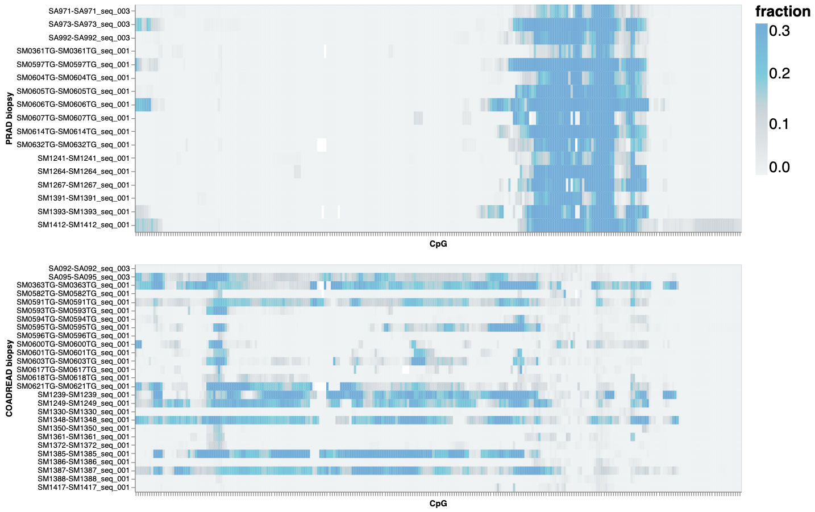
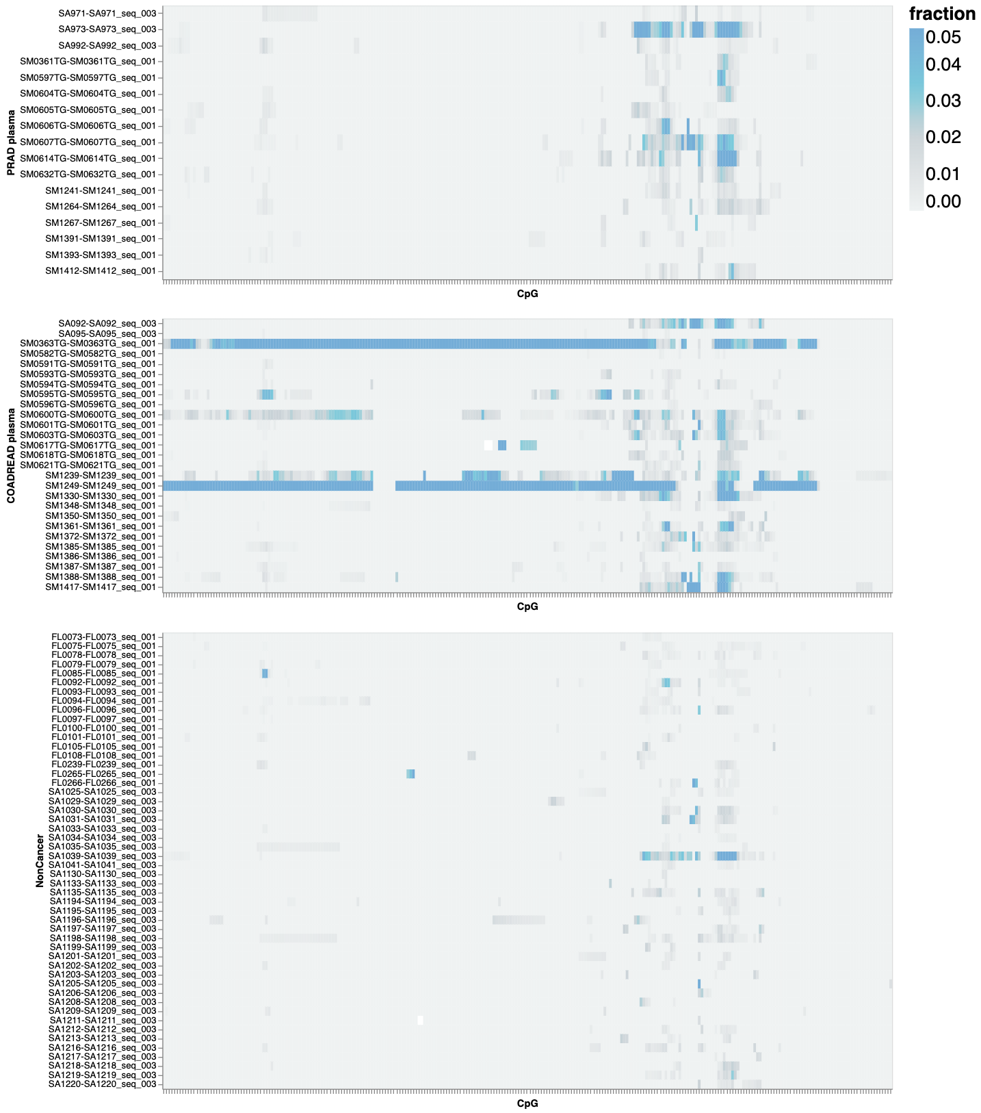
Big data… but low signal: two major modeling challenges
One Patient
Pancreas Tumor Tissue
Matched
Plasma
Patient
40Gb, 10k+ regions
Signal at position
Signal at position
Each patient generates a large, high-dimensional dataset
But the majority of that data is non-tumor: cancer signal in plasma is extremely sparse
Notes:
* Each patient generates a wealth of data… 40gb over 10k regions… high dimensional dataset
But in plasma, MOST of that data is non-tumor…
Middle figure shows the cancer signal in actual tumor tissue vs. plasma from the same patient
Each row is one patient, left is data from their tumor tissue and right is data from their plasma
So x axis is genomic position, more blue = more signal…
Can see that even if signal is very strong in tissue, the signal that makes it into the plasma is often extremely sparse
This especially true of EARLY cancers (our main focus) in which the rates of shedding of the tumor cells are lower…

Slide 8
Big data… but low signal: two major modeling challenges
One Patient
Pancreas Tumor Tissue
Matched
Plasma
1. Need highly sensitive models that are robust to noise
Patient
40Gb, 10k+ regions
Signal at position
Signal at position
Each patient generates a large, high-dimensional dataset
But the majority of that data is non-tumor: cancer signal in plasma is extremely sparse
Notes:
* Each patient generates a wealth of data… 40gb over 10k regions… high dimensional dataset
But in plasma, MOST of that data is non-tumor…
Middle figure shows the cancer signal in actual tumor tissue vs. plasma from the same patient
So x axis is genomic position, more blue = more signal… each row is a patient
Can see that even if signal is very strong in tissue, the signal that makes it into the plasma is often extremely sparse
This especially true of EARLY cancers (our main focus) in which the rates of shedding of the tumor cells are lower…
But this is what we care about doing – detecting in plasma let’s us do the minimal invasive LB.
To consistently detect sparse signal like this, need highly sensitive models that robust to noise

Slide 9
Big data… but low signal: two major modeling challenges
One Patient
Pancreas Tumor Tissue
Matched
Plasma
1. Need highly sensitive models that are robust to noise
Patient
40Gb, 10k+ regions
Signal at position
Signal at position
Each patient generates a large, high-dimensional dataset
But the majority of that data is non-tumor: cancer signal in plasma is extremely sparse
2. Training such models requires more data than is available in sparse plasma
Notes:
* Each patient generates a wealth of data… 40gb over 10k regions… high dimensional dataset
But in plasma, MOST of that data is non-tumor…
Middle figure shows the cancer signal in actual tumor tissue vs. plasma from the same patient
So x axis is genomic position, more blue = more signal… each row is a patient
Can see that even if signal is very strong in tissue, the signal that makes it into the plasma is often extremely sparse
This especially true of EARLY cancers (our main focus) in which the rates of shedding of the tumor cells are lower…
But this is what we care about doing – detecting in plasma let’s us do the minimal invasive LB.
To consistently detect small signal like this, need highly sensitive models that robust to noise
Requires more data than we really have…

Slide 10
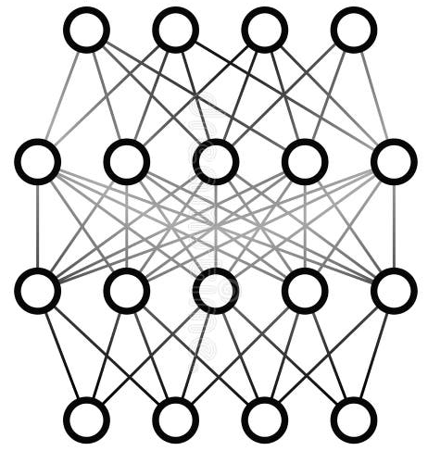
Contributions
x
Improvement
Highly sensitive convolutional neural network model for detecting tumor signal in cell-free DNA
Large-scale data generation + training procedure for liquid biopsy… 1.3 billion training examples
Up to 14-point gain in early-stage sensitivity, and improved robustness

Slide 11
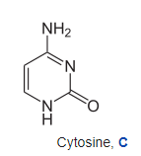
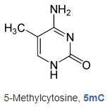
Background: DNA Methylation
Ref:
CGGGACGTCTCGTACCGTATCG
m
m
Epigenetic marker
Read1:
ACGTCTCGTACCGTA
Notes:
Quick primer on methylation… epigenetic marker... Attachment of a methyl group to a cytosine

Slide 12
Background: DNA Methylation
Ref:
CGGGACGTCTCGTACCGTATCG
m
m
Epigenetic marker
Focus on CpG contexts, where most methylation occurs
Biomarker: Tumor DNA is hypo/hypermethylated compared to healthy population in certain genomic regions
Read1:
ACGTCTCGTACCGTA
Notes:
Quick primer on methylation… epigenetic marker... Attachment of a methyl group to a cytosine
We’ll focus on CpG contexts, where most DNA methylation occurs
We care about this because in certain regions of the genome, tumor DNA is hypo/hypermethylated compared to healthy cells… so those differentially methylated fragments are the needles we’re looking for
Indicated here on the read…

Slide 13
Background: DNA Methylation
Ref:
CGGGACGTCTCGTACCGTATCG
m
m
Epigenetic marker
Focus on CpG contexts, where most methylation occurs
Biomarker: Tumor DNA is hypo/hypermethylated compared to healthy population in certain genomic regions
Read1:
ACGTCTCGTACCGTA
Read1
Numerical encoding:
0 | 2 | 1 | 2 | 0
Biology | Numerical Encoding
No coverage | 0
Unmeythlated CpG | 1
Methylated CpG | 2
Encodes both methylation and alignment position
Notes:
Quick primer on methylation… epigenetic marker... Attachment of a methyl group to a cytosine
We’ll focus on CpG contexts, where most DNA methylation occurs
We care about this because certain regions of the genome tumor DNA is hypo/hypermethylated compared to healthy cells… so those differentially methylated fragments are the needles we’re looking for
Indicated here on the read…
Start to build up how we can translate this information to an image…
Example here in how encode both the read’s position and methylation states together…
So first CpG position is 0 b/c no coverage, second CpG is a 2 b/c methylated in the read, third CpG is 1 b/c covered but unmethylated…

Slide 14
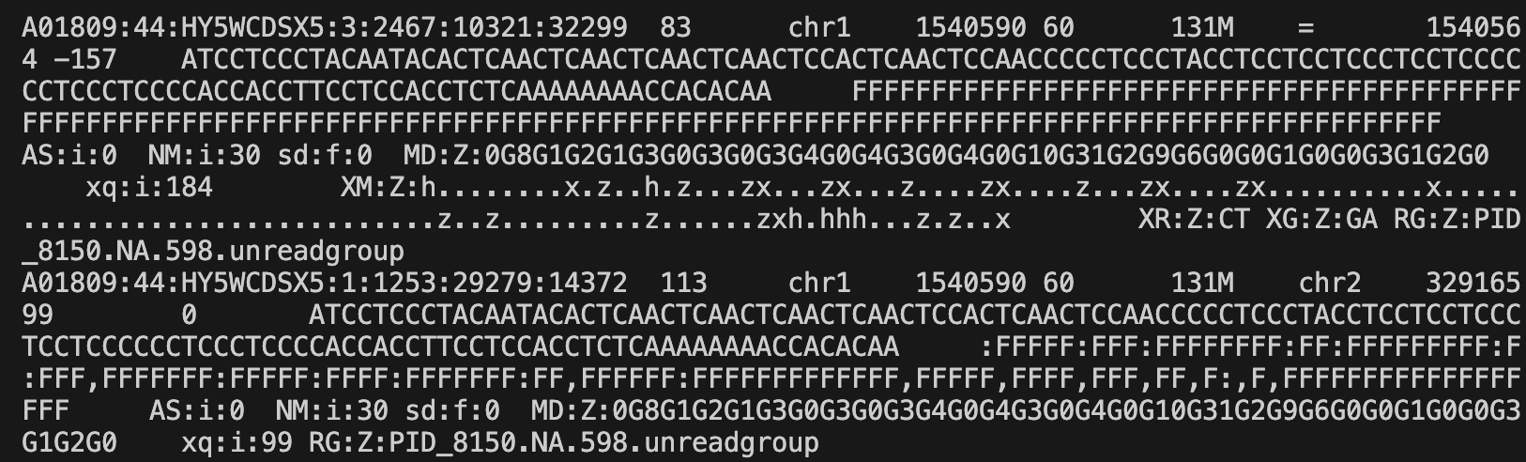
Methylated read pileups as images
Bam file (contains aligned reads)
Get all reads that overlap a given region
Fast IGV-like pileup algorithm that ensures no reads overlap
Numerical encoding of read pileup
2 | 1 | 1 | 1 | 1 | 1 | 1 | 1 | 1 | 1 | 0 | 0 | 0 | 0 | 0 | 0 | 0 | 0 | 0
1 | 0 | 2 | 1 | 1 | 1 | 1 | 1 | 1 | 1 | 1 | 1 | 0 | 0 | 0 | 0 | 0 | 0 | 0
1 | 1 | 1 | 2 | 1 | 1 | 1 | 1 | 1 | 1 | 1 | 1 | 0 | 0 | 0 | 0 | 0 | 0 | 0
1 | 1 | 1 | 1 | 0 | 0 | 0 | 0 | 0 | 1 | 1 | 1 | 1 | 1 | 1 | 1 | 1 | 2 | 1
Notes:
Key in our approach is analyzing large batches of reads… look at the whole haystack at once
So giving an example for one sample here. Pick a genomic region… get all the reads overlapping that region from the bam.
We implemented a fast IGV-like pileup algorithm that puts reads in unique rows such that no reads overlap…

Slide 15
Methylated read pileups as images
Bam file (contains aligned reads)
Efficiency
Get all reads that overlap a given region
Fast IGV-like pileup algorithm that ensures no reads overlap
50 CpG x 5000 reads is ~0.15s per pileup
Fast + parallelizable
Numerical encoding of read pileup
2 | 1 | 1 | 1 | 1 | 1 | 1 | 1 | 1 | 1 | 0 | 0 | 0 | 0 | 0 | 0 | 0 | 0 | 0
1 | 0 | 2 | 1 | 1 | 1 | 1 | 1 | 1 | 1 | 1 | 1 | 0 | 0 | 0 | 0 | 0 | 0 | 0
1 | 1 | 1 | 2 | 1 | 1 | 1 | 1 | 1 | 1 | 1 | 1 | 0 | 0 | 0 | 0 | 0 | 0 | 0
1 | 1 | 1 | 1 | 0 | 0 | 0 | 0 | 0 | 1 | 1 | 1 | 1 | 1 | 1 | 1 | 1 | 2 | 1
Notes:
Key in our approach is analyzing large batches of reads… look at the whole haystack at once
So giving an example for one sample here. Pick a genomic region… get all the reads overlapping that region from the bam.
We implemented a fast IGV-like pileup algorithm that puts reads in unique rows such that no reads overlap…
A quick highlight that this process needs to be very efficient since we will call it many times during training… and it is… fraction of a second, very fast and parallel

Slide 16
Methylated read pileups as images
Bam file (contains aligned reads)
Biology | Numerical Encoding | Color
No coverage | 0 | Dark blue
Unmeythlated CpG | 1 | Pink
Methylated CpG | 2 | Red
Efficiency
Get all reads that overlap a given region
Fast IGV-like pileup algorithm that ensures no reads overlap
50 CpG x 5000 reads is ~0.15s per pileup
Fast + parallelizable
Numerical encoding of read pileup
Image representation of read pileup
2 | 1 | 1 | 1 | 1 | 1 | 1 | 1 | 1 | 1 | 0 | 0 | 0 | 0 | 0 | 0 | 0 | 0 | 0
1 | 0 | 2 | 1 | 1 | 1 | 1 | 1 | 1 | 1 | 1 | 1 | 0 | 0 | 0 | 0 | 0 | 0 | 0
1 | 1 | 1 | 2 | 1 | 1 | 1 | 1 | 1 | 1 | 1 | 1 | 0 | 0 | 0 | 0 | 0 | 0 | 0
1 | 1 | 1 | 1 | 0 | 0 | 0 | 0 | 0 | 1 | 1 | 1 | 1 | 1 | 1 | 1 | 1 | 2 | 1
Notes:
Key in our approach is analyzing large batches of reads… look at the whole haystack at once
So giving an example for one sample here. Pick a genomic region… get all the reads overlapping that region from the bam.
We implemented a fast IGV-like pileup algorithm that puts reads in unique rows such that no reads overlap…
A quick highlight that this process needs to be very efficient since we will call it many times during training… and it is… fraction of a second, very fast and parallel
Now generating the image is easy as mapping numbers to colors. I’ll use this mapping throughout.
So each pink/red line is one read... Red squares are methylated CpGs, pink squares are unmethylated, blue is no coverage

Slide 17
Handling variable size of genomic input
Encoded data has variable length
based on # of reads in the bam
Based on # of CpGs in the region
Rows are resized with padding or subsampling
Columns are resized with standard image transformation techniques
Pileup 1
Pileup 2
Pileup 1
Pileup 2
Subsample
(since too
many reads)
Pad
(since not
enough reads)
Notes:
Possibly cut?
A few advantages of the image encoding – one of the important ones is handling variable coverage and region sizes – use padding/interpolation to quickly standardize inputs
Beauty of CNNs is as long as you’re not including an order of magnitude in the range of how you’re scaling, its perfectly happy to learn well over these rescalings

Slide 18
Convolutional neural network extracts key features from pileups
Bam file for PID_042
Genomic region: CGI_12
Image input
ResNet18 backbone
Get features:
 | F1-CGI_12 | F2-CGI_12 | F3-CGI_12 | F4-CGI_12 | F5-CGI_12 | F6-CGI_12
PID_042 | 0.1 | 1.2 | -0.4 | 2.4 | 0.8 | 3.1
Use features for downstream tasks (e.g., cancer detection)
Identify the tumor-derived reads
with saliency maps
Notes:
Now we can build the full pipeline…
Get reads from one sample in one region
Assemble the image
Pass through the conv net (resnet)
Then get two key outputs: 1) a feature set that compactly describes tumor signal in the image
And a saliency map allowing us to interrogate which parts of the image (i.e., which reads) were likely from tumor

Slide 19
How to train: Using raw plasma data is problematic
Sample sparsity
f
Early stage cfDNA cancer data is rare and costly to collect
*SEER 2021
Notes:
So that’s all well and good, but deep models have millions+ parameters… very data hungry
Situation is not good if looking only at raw data… two reasons for this
Collecting cancer samples is hard … especially for early-stage samples, there just aren’t that many (at least at the scale needed for training deep models)
~50,000 per year, fraction of that are early stage…

Slide 20
How to train: Using raw plasma data is problematic
Sample sparsity
Signal sparsity
f
f
Two sources:
Each patient’s tumor has a different signature
Each tumor has different rates of cell death/DNA shedding
Empirical estimate: ~25% of our cancer plasma has tumor signal at any given genomic region
Majority of labels for plasma data are incorrect at the region level… leads to low-quality models
Early stage cfDNA cancer data is rare and costly to collect
*SEER 2021
*CoreHH study data
Notes:
So that’s all well and good, but deep models have millions+ parameters… super data hungry
Situation is not good if looking only at raw data… two reasons for this
Collecting cancer samples is hard … especially for early-stage samples, there just aren’t that many (at least at the scale needed for training deep models)
Second, the signal in the samples that you do manage to collect are… unreliable (in the training sense).
Every tumor has a different signature across the genome
Each tumor has different rates of cell death/shedding of tumor DNA into the blood stream
Empirical estimate from our data: Only~25% of cancer plasma has tumor signal at any given genomic region
So 75% of your positive training examples have the wrong label… leads to low quality models

Slide 21
Solved with region-level plasma data generation
Non-cancer
Plasma
Cancer
Plasma
Cancer
Biopsy
User selects:
Genomic region
Level of background noise
Level of signal
Data generation
*Proprietary
Notes:
So how do we solve this? By generating massive amounts of high quality training data
Input source plasma and biopsy… really let us understand what the data should look like when generating.
User selects genomic region, level of background noise, and level of signal

Slide 22
Solved with region-level plasma data generation
Non-cancer
Plasma
Cancer
Plasma
Cancer
Biopsy
User selects:
Genomic region
Level of background noise
Level of signal
Data generation
*Proprietary
Key features:
Background noise is shared
Signal present in the cancer image with high probability
Unique pair of images:
one cancer and one non-cancer
Notes:
So how do we solve this? By generating massive amounts of high quality training data
Input source plasma and biopsy… really let us understand what the data should look like when generating.
User selects genomic region, level of background noise, and level of signal
Each “Click” of generate creates a matched cancer and non-cancer pair…
Two keys: background noise + any potential confounding between the two samples is shared
Solving the signal sparsity problem… Signal is present in the cancer sample with high probability… empirical estimate of 80-90% (and we can tune it)

Slide 23
Solved with region-level plasma data generation
Non-cancer
Plasma
Cancer
Plasma
Cancer
Biopsy
User selects:
Genomic region
Level of background noise
Level of signal
Data generation
*Proprietary
Key features:
Background noise is shared
Signal present in the cancer image with high probability
Unique pair of images:
one cancer and one non-cancer
High quality training data with minimal confounding
Can generate billions of unique images
Why this matters
Notes:
So how do we solve this? By generating massive amounts of high quality training data
Input source plasma and biopsy… really let us understand what the data should look like when generating.
User selects genomic region, level of background noise, and level of signal
Each “Click” of generate creates a matched cancer and non-cancer pair…
Two keys: background noise + any potential confounding between the two samples is shared
Solving the signal sparsity problem… Signal is present in the cancer sample with high probability
Why does this matter? We can generate billions of unique high quality training data with minimal confounding

Slide 24


Training + data flow
S3 Bucket with all bams
Regions 1-25
Region 1
Subset bams to region
One Run
Pre-train on biopsy
1 GPU
64x CPU
Train on generated data
Data is generated in real-time
Produce inferences on real cfDNA
Notes:
Snapshot of our workflow, with some computational stats
Key is we slice the genome into separate models, and parallelize to make everything tractable and fast
Each model gets 25 regions and relevant subset of the bams.
Then pre-train on biopsy, then get into the meat of the training, hundreds of epochs on generated data which we generate on the fly, unique samples each batch.
When complete, we use the trained model to extract features from REAL held out plasma data.

Slide 25
Training + data flow
S3 Bucket with all bams
Regions 1-25
Region 1
Parallelize over 5415 regions
Subset bams to region
One Run
3,600 GPU hours
240,000 CPU hours
1.3B training examples
218 models
24 hours
Pre-train on biopsy
1 GPU
64x CPU
Train on generated data
Data is generated in real-time
Produce inferences on real cfDNA
Concatenate inferences from all regions
Notes:
Snapshot of our workflow, with some computational stats
Key is we slice the genome into separate models, and parallelize to make everything tractable and fast
Each model gets 25 regions and relevant subset of the bams.
Then pre-train on biopsy, then get into the meat of the training, hundreds of epochs on generated data which we generate on the fly, unique samples each batch.
When complete, we use the trained model to extract features from REAL held out plasma data.
Parallelizing this on next flow, we cover 5k regions, 3,600 Gpu hours, 240k CPU hours, 1.3B training examples, 200 models in about a day

Slide 26
Training + data flow
S3 Bucket with all bams
Regions 1-25
Region 1
Parallelize over 5415 regions
Subset bams to region
One Run
3,600 GPU hours
240,000 CPU hours
1.3B training examples
218 models
24 hours
Pre-train on biopsy
1 GPU
64x CPU
Train on generated data
Data is generated in real-time
Costs
Produce inferences on real cfDNA
Data input
N=130 plasma
N=462 biopsy
Training: $2 per CGI
Inference: $0.25 per sample
Concatenate inferences from all regions
Notes:
Snapshot of our workflow, with some computational stats
Key is we slice the genome into separate models, and parallelize to make everything tractable and fast
Each model gets 25 regions and relevant subset of the bams.
Then pre-train on biopsy, then get into the meat of the training, hundreds of epochs on generated data which we generate on the fly, unique samples each batch.
When complete, we use the trained model to extract features from REAL held out plasma data.
Parallelizing this on next flow, we cover 5k regions, 3,600 Gpu hours, 240k CPU hours, 1.3B training examples, 200 models in about a day
Robert had some stats on CPU/GPU hours and the cost-per-unit… interesting part of what we’ve done here… at $0.25 per sample, it’s a negligible addition to lab and sequencing costs
Very practical.

Slide 27
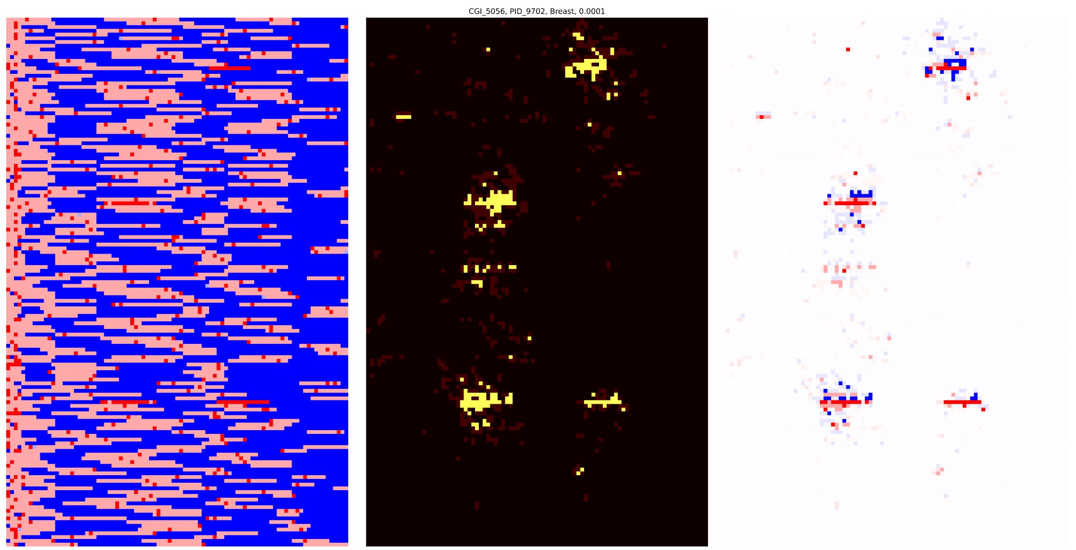
Validation: Saliency maps show network focuses on tumor reads
Sequence reads of a stage II breast cancer sample
Areas that network has identified as important
CpGs in one genomic region
Highlighted pixels are areas that the model has identified as important in classifying this sample as cancer
The model has correctly detected the four fully methylated reads that are indicative of cancer in this region
Sequence reads
Unmethylated CpG
Methylated CpG
No Coverage
Each line is one sequence read
Notes:
Visual validation… real stage II breast cancer sample on the left…
on the right is a saliency map showing where one of our trained CNN determined were important reads for classifying this image as a cancer example
Its very good at finding tumor reads against a background of noise

Slide 28



CORE-HH, The Cancer ORigins Epigenetics Three-part, case-control study
NCT05435066
N=1238 non-cancers
N=1115 cancers (N=602 Stage I/II)
21 indications
Recently diagnosed, treatment-naïve
Results from first study part 1 (no blinding)
Notes:
More complete evaluation on clinical data
CoreHH study, roughly 1000 each of cancers and non-cancers, 21 indications
Prospective cohort
Results from study part 1 (no blinding)

Slide 29
Neural network features significantly improve early-stage sensitivity
Data:
Neural network (CNN): Features for 5415 regions
Baseline (Mean methyl): Mean region methylation over the same
Models:
RBF-Kernel PCA + Logistic regression
XGBoost
Notes:
Describe the data in two ways: CNN features, and ”standard” metric of mean methylation over the same regions (think adding up all the red in those images)
Train models on each dataset… logistic regression with some non-linear transform and XGBoost, report on the best for each dataset

Slide 30
Neural network features significantly improve early-stage sensitivity
Data:
Neural network (CNN): Features for 5415 regions
Baseline (Mean methyl): Mean region methylation over the same
Models:
RBF-Kernel PCA + Logistic regression
XGBoost
Method: 10x5 Cross validation with CoreHH data
Metric: Sensitivity at 98% specificity
Fold:
+8.9
test
+13.8
test
test
+6.9
Recombine test sets
test
Example 3x1 cross validation
Notes:
Describe the data in two ways: CNN features, and ”standard” metric of mean methylation over the same regions (think adding up all the red in those images)
Train models on each dataset… logistic regression with some non-linear transform and XGBoost, report on the best for each dataset
10x5 cross validation…CV example right, train on 66%, test on the other 33%, repeat until have held out predictions for all samples… then report on the combined test set
Metric of interest is sens at 98% spec.

Slide 31
Neural network features significantly improve early-stage sensitivity
Data:
Neural network (CNN): Features for 5415 regions
Baseline (Mean methyl): Mean region methylation over the same
Models:
RBF-Kernel PCA + Logistic regression
XGBoost
Method: 10x5 Cross validation with CoreHH data
Metric: Sensitivity at 98% specificity
+8.9
+13.8
Sensitivity
+6.9
+3.6
+10.1
N=378
224
193
249
111
Stage
Neural network features significantly improve early-stage performance at high specificity
Notes:
Describe the data in two ways: CNN features, and ”standard” metric of mean methylation over the same regions (think adding up all the red in those images)
Train models on each dataset… logistic regression with some non-linear transform and XGBoost, report on the best for each dataset
10x5 cross validation… train on 90%, test on the other 10%, repeat until have held out predictions for all samples… then report on the combined test set
Metric of interest is sens at 98% spec.
10 point boost in stage I, 7 in stage II, 13 in stage III… significant gains

Slide 32
Correlations with confounders
Incomplete bisulfite conversion
Unmethylated C’s are incorrectly recorded as methylated
Older patients:
more likely to have cancer
have higher methylation
Patient Age
% CC Content
Goal
Non-cancer prediction scores should be uncorrelated with these confounders
Notes:
Also care deeply about robustness… new lab processes or clinical populations over time
To make robust, want our predictions to NOT be correlated with confounders
Two known ones… age (explain)
Incomplete bisulfite conversion… falsely inflates methylation levels

Slide 33
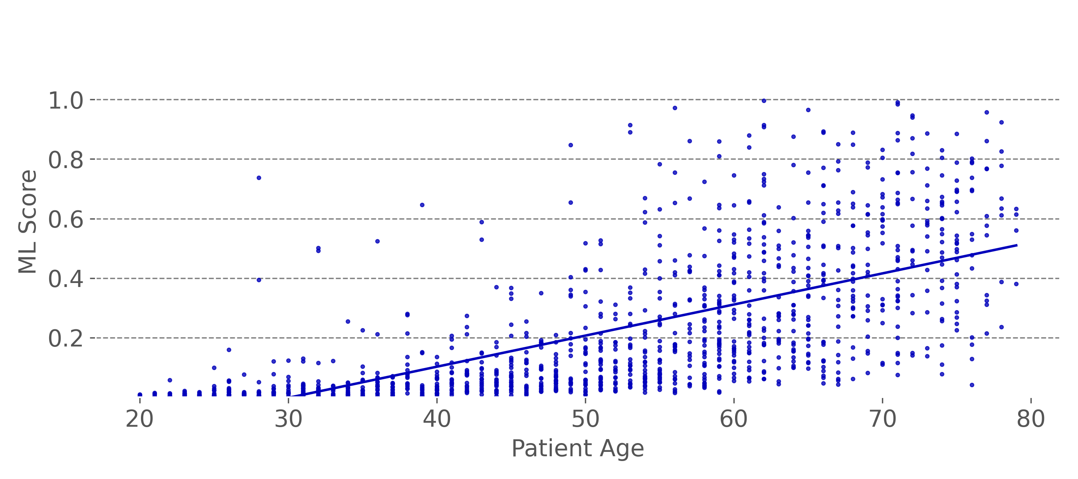
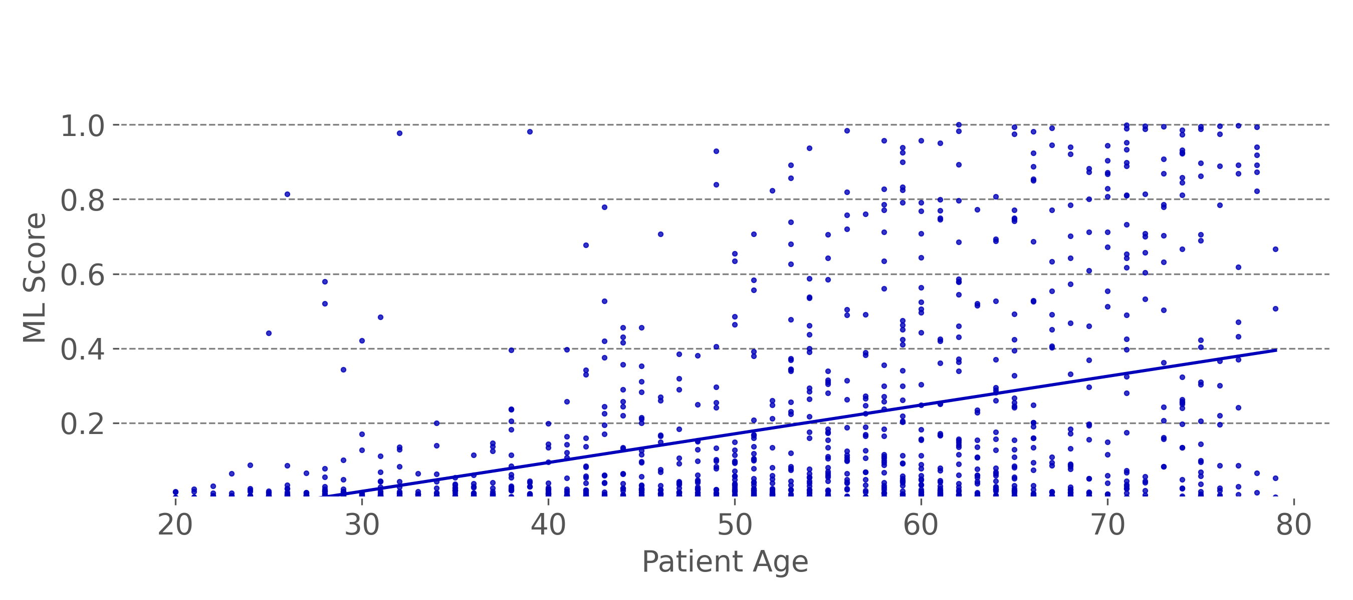
Neural network reduces correlation with confounders (age, %CC)
Baseline non-cancer age correlation: 0.60
CNN Non-cancer age correlation: 0.35
Notes:
CNN reduces confounding in both
Top row is age
Left is baseline model (0.6 age correlation)
Right is CNN – age correlation reduced by 50% … significant gain

Slide 34
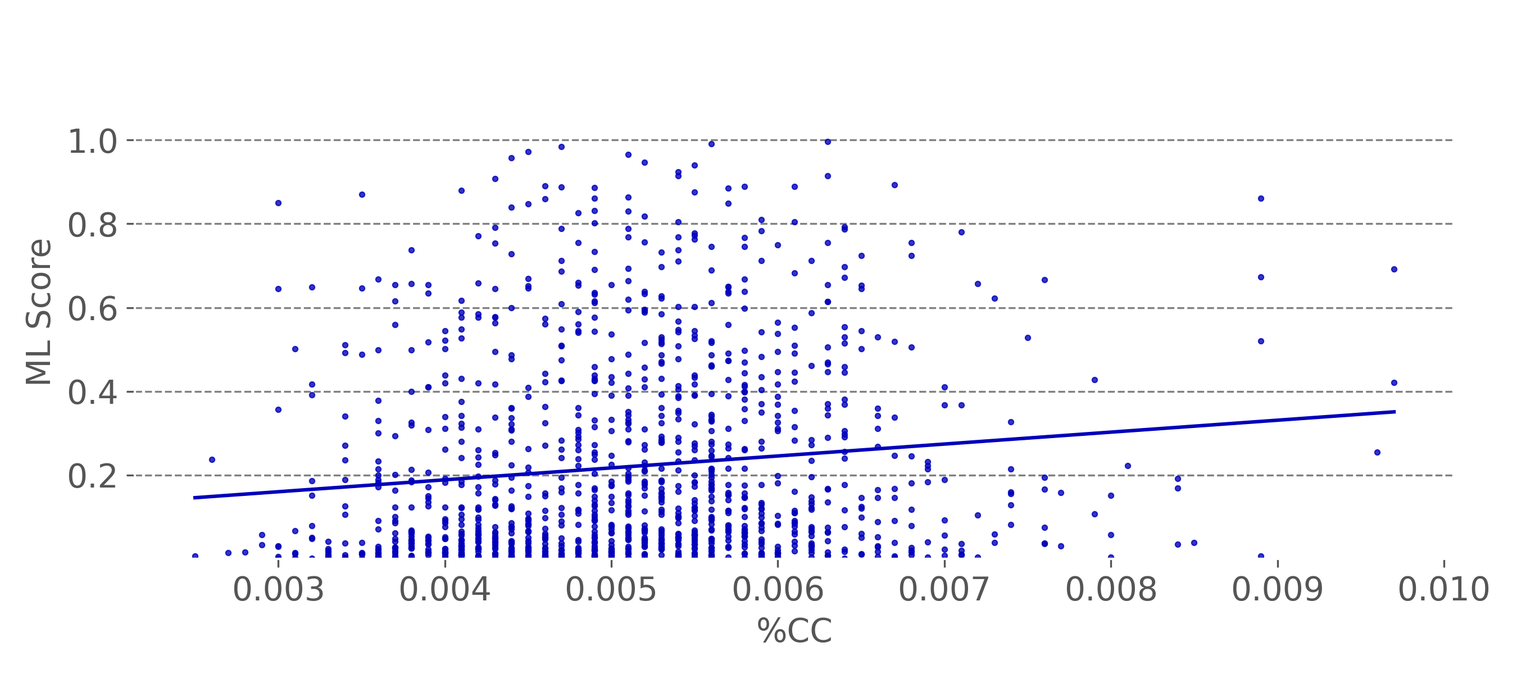
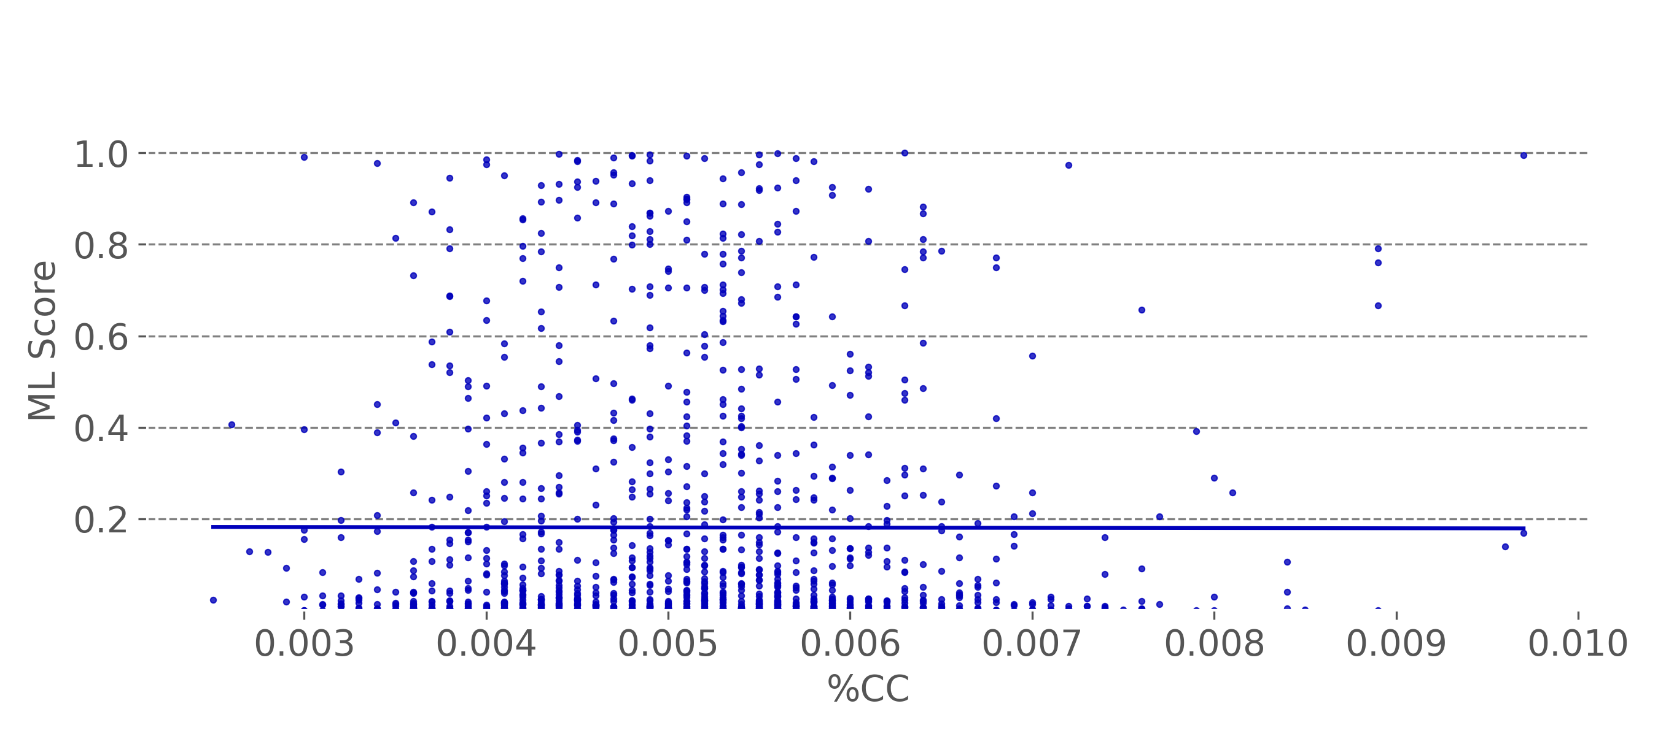
Neural network reduces correlation with confounders (age, %CC)
Baseline non-cancer age correlation: 0.60
CNN Non-cancer age correlation: 0.35
Baseline non-cancer %CC correlation: 0.12
CNN Non-cancer %CC correlation: 0.0
Notes:
CNN reduces confounding in both
Top row is age
Left is baseline model (0.6 age correlation)
Right is CNN – age correlation reduced by 50% … significant gain
Bottom row, %cc reduce from 0.12 to 0.

Slide 35
Conclusion
x
Improvement
Highly sensitive convolutional neural network model for detecting tumor signal in cell-free DNA
Large-scale data generation + training procedure for liquid biopsy… 1.3 billion training examples
Up to 14-point gain in early-stage sensitivity, and improved robustness
Notes:
CNN for highly sensitive detection of tumor reads
Powered by large-scale data generation and training procedure for liquid biopsy data
Giving us significant gains in early-stage sensitivity (and robustness)

Slide 36
CSHL Biological Data Science 2024
Thank you
Jackson A Killian¹, Dorna Kashef¹, Kade Pettie¹, Kyle Gowen¹, Shiva Farashahi¹, Esther Brown², Feras Hantash², Jocelyn Charlton¹, Kieran I Chacko¹
¹Harbinger Health, Machine Learning and Computational Biology, Cambridge, MA,
²Harbinger Health, Clinical Laboratory, Cambridge, MA
Notes:
* Thank you organizers, audience, co-authors, everyone at Harbinger and our collaborators who make this possible.

Slide 37
Appendix

Slide 38
Augmentation: Encoded data is shuffled row-wise
2 | 1 | 1 | 1 | 1 | 1 | 1 | 1 | 1 | 1 | 0 | 0 | 0 | 0 | 0 | 0 | 0 | 0 | 0
1 | 0 | 2 | 1 | 1 | 1 | 1 | 1 | 1 | 1 | 1 | 1 | 0 | 0 | 0 | 0 | 0 | 0 | 0
1 | 1 | 1 | 2 | 1 | 1 | 1 | 1 | 1 | 1 | 1 | 1 | 0 | 0 | 0 | 0 | 0 | 0 | 0
1 | 1 | 1 | 1 | 0 | 0 | 0 | 0 | 0 | 1 | 1 | 1 | 1 | 1 | 1 | 1 | 1 | 2 | 1
Shuffle rows
1 | 1 | 1 | 2 | 1 | 1 | 1 | 1 | 1 | 1 | 1 | 1 | 0 | 0 | 0 | 0 | 0 | 0 | 0
2 | 1 | 1 | 1 | 1 | 1 | 1 | 1 | 1 | 1 | 0 | 0 | 0 | 0 | 0 | 0 | 0 | 0 | 0
1 | 1 | 1 | 1 | 0 | 0 | 0 | 0 | 0 | 1 | 1 | 1 | 1 | 1 | 1 | 1 | 1 | 2 | 1
1 | 0 | 2 | 1 | 1 | 1 | 1 | 1 | 1 | 1 | 1 | 1 | 0 | 0 | 0 | 0 | 0 | 0 | 0
Adding randomness to data without losing information
improves training by preventing overfitting
Notes:
This is interesting enough to potentially add back

Slide 39
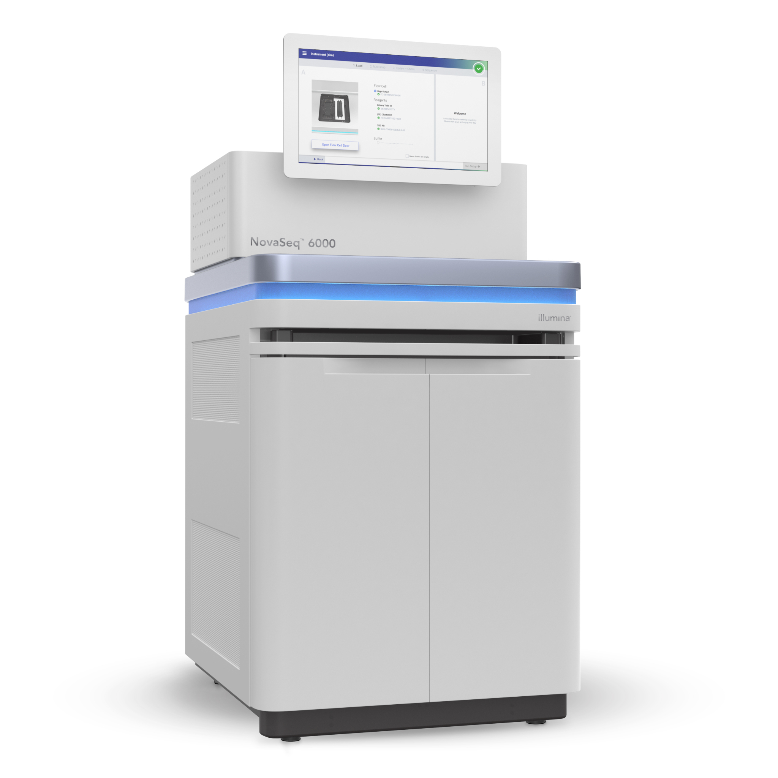
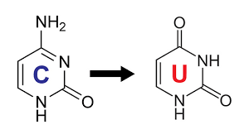
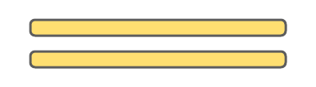
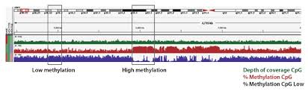
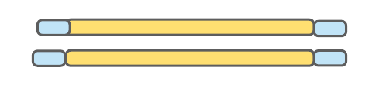
Harbinger’s liquid biopsy detects cancer in plasma
DNA Extraction | Bisulfite Conversion | Library Generation | Hybrid Capture | Sequencing | Data Analysis
Isolate cfDNA From blood plasma. | Tag methylation events | Barcode each DNA sample and prepare samples for sequencing | Enrich sample for regions of interest | Analyzes DNA composition | Convert raw sequencing data into processable fragments

Slide 40
Low signal in cfDNA: Need for sensitive and robust models
Tissue Biopsy
Matched Plasma
Patient
Strength of cancer signal at genomic position
Strength of cancer signal at genomic position
While all biopsy samples exhibit a strong signal in this region, the plasma samples show a significantly weaker signal
Notes:
TODO: highlight this is matched tissue + plasma
Might need to define CpG and methylation

Slide 41
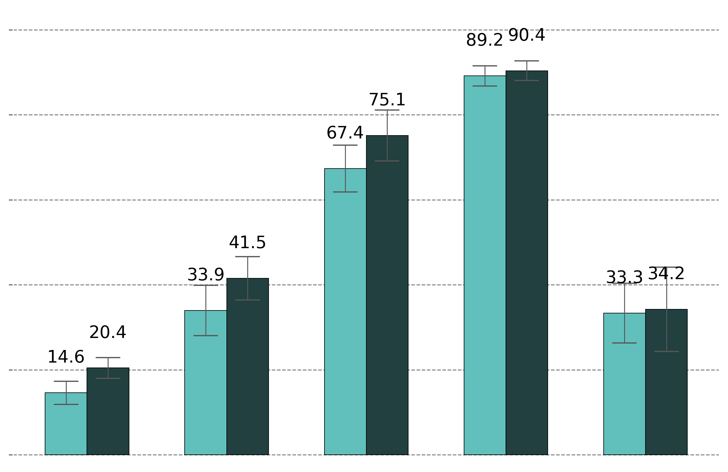
Results vs. 5-metrics
Stage-wise sensitivity, 98% target specificity
+1.2% pt.
100%
+7.7% pt.
80%
60%
+7.6% pt.
Sensitivity
+0.9% pt.
40%
+5.8% pt.
40%
20%
0%
 | I | II | III | IV | Unknown
 | N = 377 | 224 | 193 | 249 | 111
Metrics + XGBoost (baseline tier II model)
ML8 + LRCV
Notes:
Original metrics: s3://pipeline-outputs-research/2024/04/ml8_benchmark_6april-4059_nft_dim10logit_corehh_B1-75_plasma_allindications_full_cgi_4059and_xgboostBayesCV_classifier-20240410-153053
ML8 run: s3://pipeline-outputs-research/2024/04/ml8_benchmark_6april-4059_nft_dim10logit_corehh_B1-75_plasma_allindications_full_ml8_LRCV_SCALE_rbfPCA_classifier-20240410-153053

Slide 42
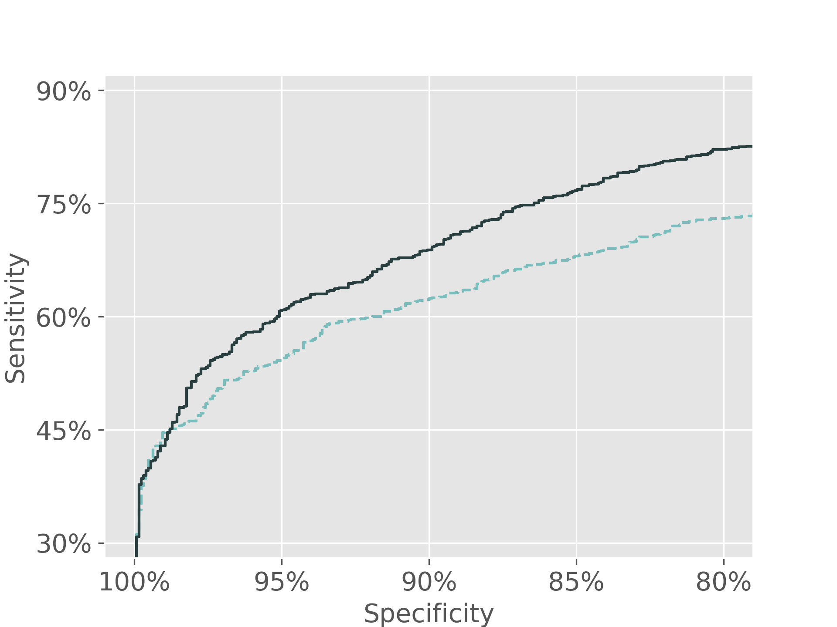
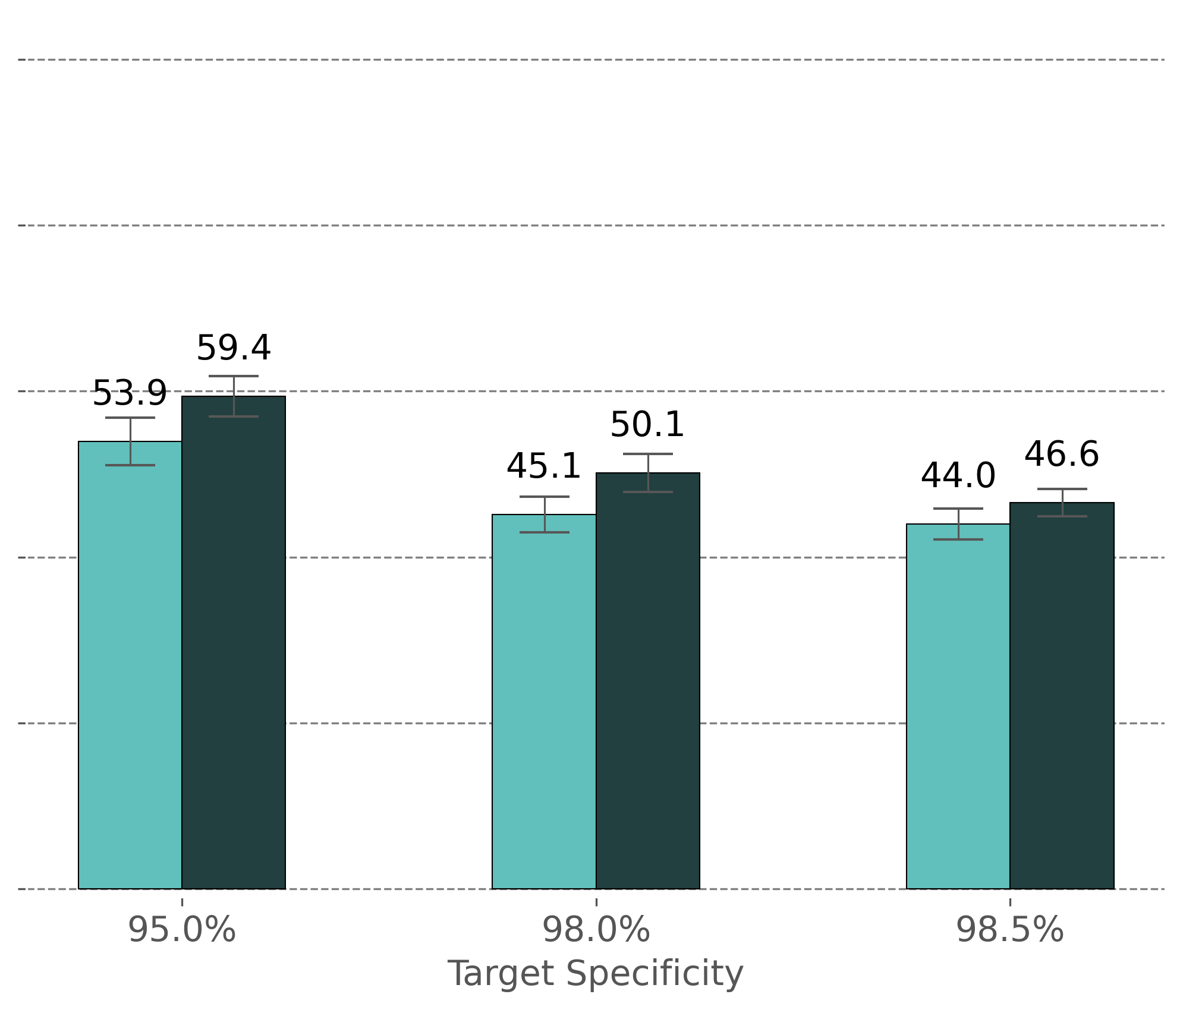
Need to update this to compare to beta model
Tier II overall performance, full cohort
100%
80%
+5.5% pt.
60%
+5.0% pt.
+2.6% pt.
Sensitivity
40%
20%
0%
Target Specificity
Metrics + XGBoost (baseline tier II model)
Data: N2750, 4518 CGIs
Metrics: 5 metrics, CovNV4
ML8: 6 features, v0_1718137523
ML8 + LRCV
Notes:
Original metrics: s3://pipeline-outputs-research/2024/04/ml8_benchmark_6april-4059_nft_dim10logit_corehh_B1-75_plasma_allindications_full_cgi_4059and_xgboostBayesCV_classifier-20240410-153053
ML8 run: s3://pipeline-outputs-research/2024/04/ml8_benchmark_6april-4059_nft_dim10logit_corehh_B1-75_plasma_allindications_full_ml8_LRCV_SCALE_rbfPCA_classifier-20240410-153053

Slide 43
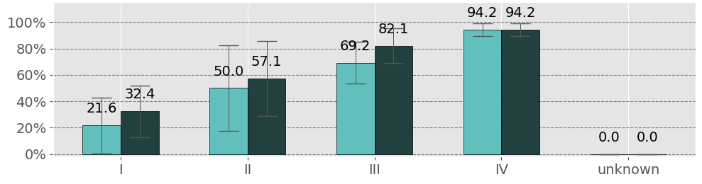
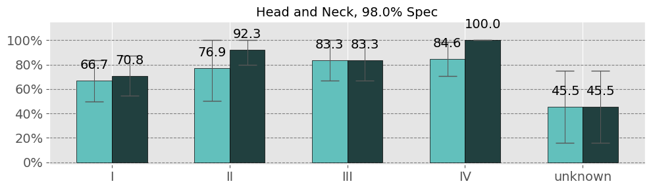
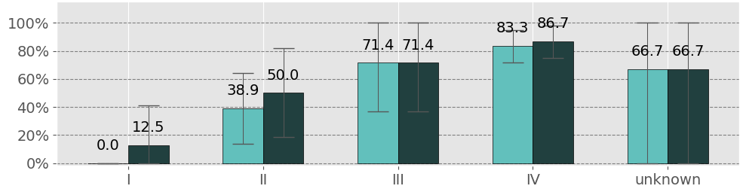
Performance by indication+stage
Lung
Sensitivity
N: | (37) | (14) | (39) | (52) | (3)
Metrics + XGBoost
(baseline tier II model)
Head and Neck
ML8 + LRCV
Sensitivity
N: | (24) | (13) | (18) | (13) | (11)
Sensitivity
Upper GI
Data: N2750, 4518 CGIs
Spec: 98%
Metrics: 5 metrics, CovNV4
ML8: 6 features, v0_1718137523
N: | (8) | (18) | (14) | (30) | (3)
Notes:
Original metrics: s3://pipeline-outputs-research/2024/04/ml8_benchmark_6april-4059_nft_dim10logit_corehh_B1-75_plasma_allindications_full_cgi_4059and_xgboostBayesCV_classifier-20240410-153053
ML8 run: s3://pipeline-outputs-research/2024/04/ml8_benchmark_6april-4059_nft_dim10logit_corehh_B1-75_plasma_allindications_full_ml8_LRCV_SCALE_rbfPCA_classifier-20240410-153053

Slide 44
ML8 non-cancer scores are less correlated with confounders
 | Age | Sex | Race* | %CC
XGBoost + Metrics | 0.601 | 0.229 | 0.257 | 0.117
ML8 | 0.347 | 0.128 | 0.183 | -0.012
*(black/white/other)
 | AT DROPOUT | MTC | Loaded Input
XGBoost + Metrics | 0.038 | -0.043 | 0.000
ML8 | 0.000 | -0.052 | 0.176
ML8 non-cancer CYN scores have similarly low correlation with
Coverage metrics
ML8 non-cancer CYN scores are more correlated with:
Input mass
Data: N2750, 4518 CGIs
Metrics: 5 metrics, CovNV4
ML8: 6 features, v0_1718137523

